Slide 1

8th Grade Math: Pre-Algebra
Unit 11, Lesson 4 Informally Fitting a Line to Bivariate Data Volume 2, pg. 193

Slide 2


Benchmarks
MA.8.DP.1.2
Given a scatter plot within a real-world context, describe patterns of association.
MA.8.DP.1.3
Given a scatter plot with a linear association, informally fit a straight line.
volume 2, pg. 193

Slide 3
Integrated Mathematical Thinking and Reasoning Standards
MA.K12.MTR.2.1 Demonstrate understanding by representing problems in multiple ways.
MA.K12.MTR.4.1 Engage in discussions that reflect on the mathematical thinking of self and others.
MA.K12.MTR.6.1 Assess the reasonableness of solutions.
MA.K12.MTR.7.1 Apply mathematics to real-world contexts.
volume 2, pg. 193

Slide 4

Learning Targets
I can describe patterns of associations in data on a scatter plot.
I can informally fit a straight line to data on a scatter plot.
volume 2, pg. 193

Slide 5

Warm-Up
volume 2, pg. 194

Slide 6
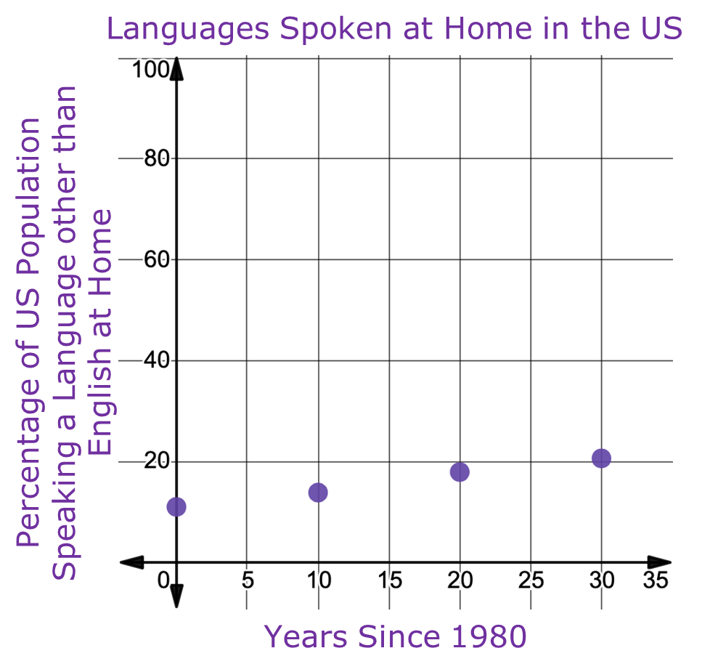

11.4.1 Warm-Up: Notice and Wonder
The graph shows the percentage of the US population $5$ years of age and older who speak a language other than English at home, according to the U.S. Census, since 1980.
What do you notice?
What do you wonder?
volume 2, pg. 194

Slide 7

Exploration
volume 2, pg. 194

Slide 8

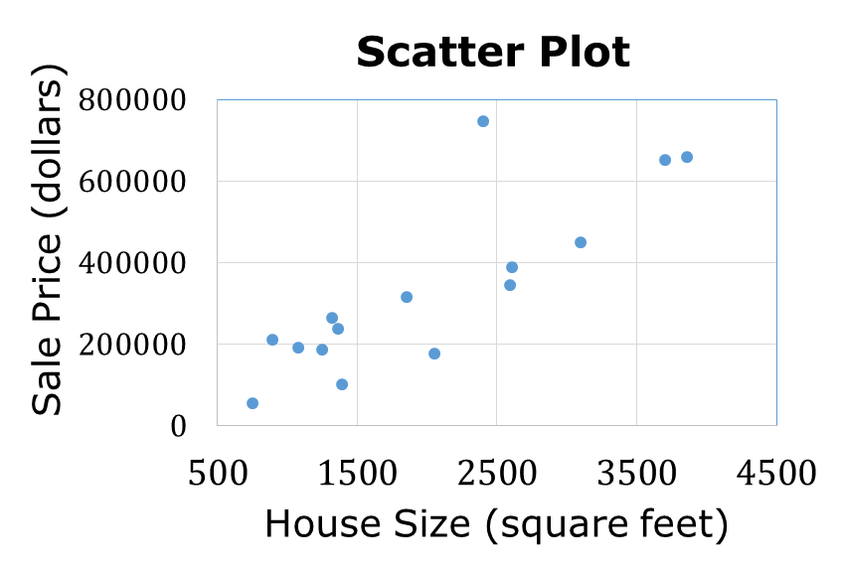
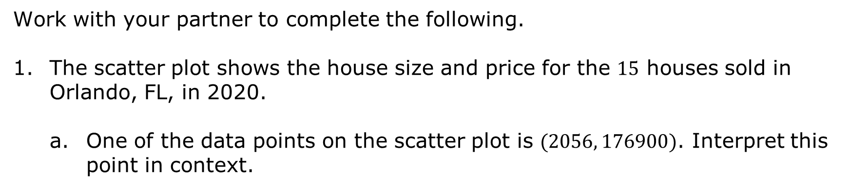
11.4.2 Exploration: Lines of Fit
Work with your partner to complete the following.
The scatter plot shows the house size and price for the $15$ houses sold in Orlando, FL, in 2020.
One of the data points on the scatter plot is $(2056, 176900)$. Interpret this point in context.
volume 2, pg. 194

Slide 9
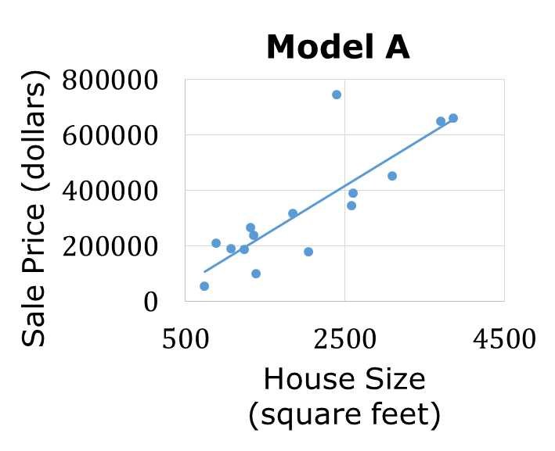
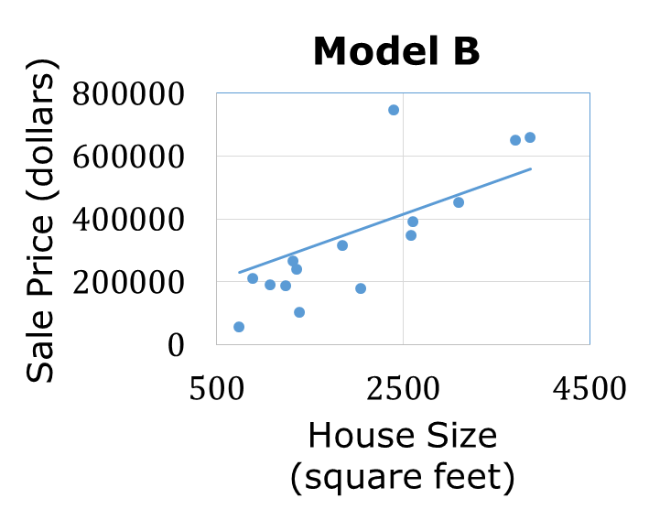
Two different lines, or models, are used to represent the relationship between house size and price on the scatter plot. Both models are shown.
What do you notice about the models?
volume 2, pg. 195

Slide 10

Work with your partner to describe the similarities and differences between the models.
Similarities | Differences
This type of model is called a line of fit.
The line of fit is a line drawn on a scatter plot to estimate the relationship between two sets of data. It is also known as a trend line.
Discuss with your partner which line appears to better estimate the relationship between house size and sale price. Summarize your discussion.
volume 2, pg. 195

Slide 11

Bring It Together
volume 2, pg. 196

Slide 12

11.4.3 Bring It Together: Fitting Lines to Model Bivariate Data
Complete the statements.
Most of the data points were below the line in Model Model had an approximately equal number of data points above and below the line. Therefore, better models the relationship between house size and sale price.
A.
B.
A
B
A
B
volume 2, pg. 196

Slide 13
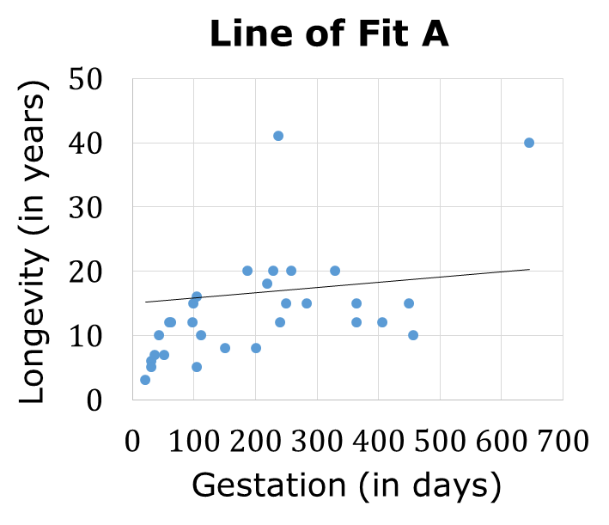
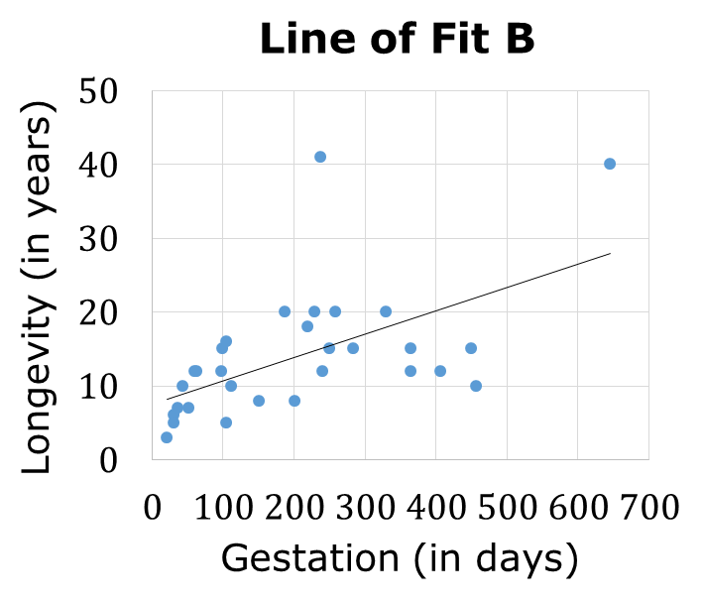
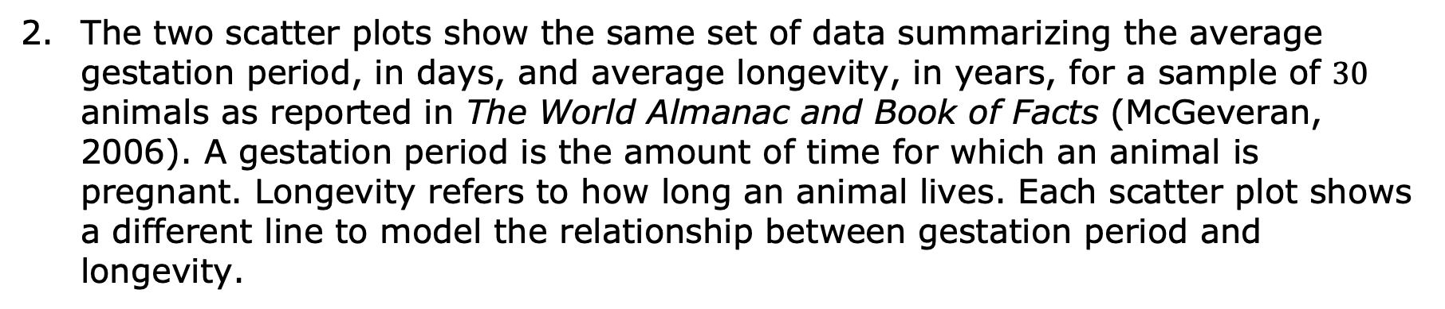
The two scatter plots show the same set of data summarizing the average gestation period, in days, and average longevity, in years, for a sample of $30$ animals as reported in The World Almanac and Book of Facts (McGeveran, 2006). A gestation period is the amount of time for which an animal is pregnant. Longevity refers to how long an animal lives. Each scatter plot shows a different line to model the relationship between gestation period and longevity.
volume 2, pg. 196

Slide 14
Explain which of the lines is a better fit to the data.
Complete the statements.
There is a association between the gestation period and longevity of an animal. The association appears to be
positive,
negative,
linear
non-linear
weak.
moderate.
strong.
volume 2, pg. 196

Slide 15
Discuss with your partner how the slope of the line and fit to the data relates to the patterns of association in a scatter plot that appears linear. Then, summarize your discussion.
Sometimes data includes outliers.
Circle the point(s) on the scatter plot that appear to be outliers in the data set.
An outlier is a value that is much higher or much lower than the other values in a set of data.
volume 2, pg. 197

Slide 16
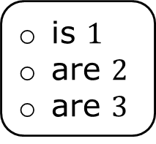
Complete the statement.
Most of the animals included in the data set follow a similar trend, modeled by the However, there animal(s) included in the data set who appear to much longer than the others, regardless of
is $1$
are $2$
are $3$
Line of Fit A.
Line of Fit B.
live
be pregnant for
how long they live.
the length of the gestation period.
volume 2, pg. 197

Slide 17

Guided Practice
volume 2, pg. 198

Slide 18

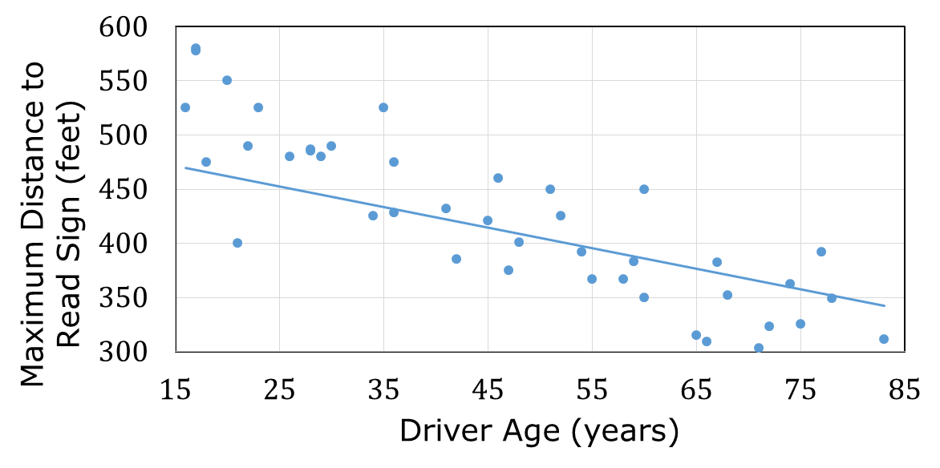
11.4.4 Guided Practice: Informally Fitting a Line
The scatter plot shows the relationship between driver age and the maximum distance to read a sign.
Explain if the line shown is a good fit for the data.
volume 2, pg. 198

Slide 19
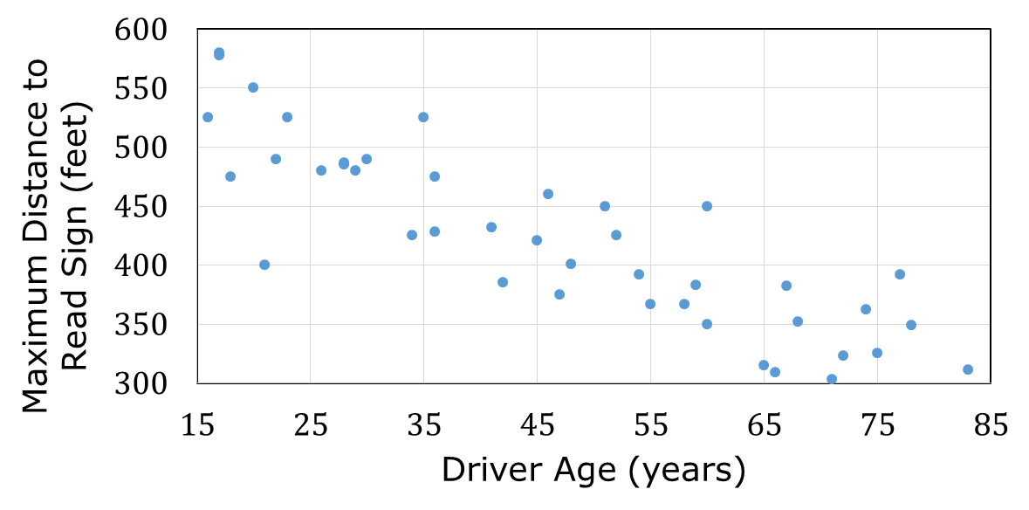
Using a straightedge, draw a line that better fits the data.
volume 2, pg. 198

Slide 20
Complete the statement.
As the independent variable the dependent variable tends to Therefore, there is a pattern of association between the variables, so the slope of the line fit to the data is
increases,
decreases,
increase.
decrease.
positive
negative
positive.
negative.
volume 2, pg. 198

Slide 21
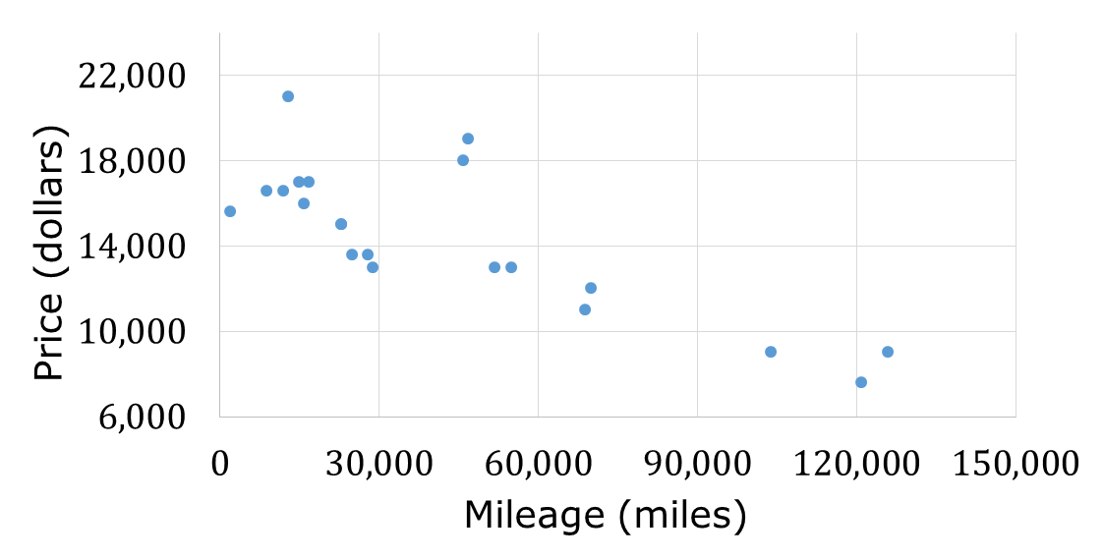

Wyatt’s Auto World sells used cars. The scatter plot displays the data for $20$ recently sold used cars by comparing the mileage of the car and its price.
Using a straightedge, draw a line of fit for the scatterplot.
volume 2, pg. 198

Slide 22
Complete the statement.
The slope of the line of fit is meaning as the mileage on a car the price Wyatt’s Auto World can sell it for
Describe any patterns of association. Use at least two words from the word bank in your description.
positive,
negative,
increases,
decreases,
increases.
decreases.
decrease(s)
non-linear
increase(s)
positive
linear
negative
volume 2, pg. 199

Slide 23

Your Turn
volume 2, pg. 199

Slide 24
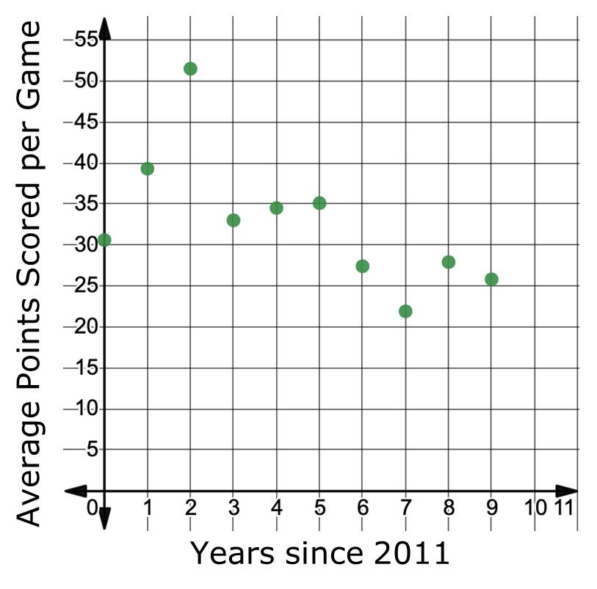
11.4.5 Your Turn!
The scatter plot shows the average points per game scored by the Florida State University (FSU) Seminoles from 2011-2020.
Use a straightedge to draw a line that models the relationship between the variables.
Describe the patterns of association. Include if any points appear to be outliers in your description.
volume 2, pg. 199

Slide 25

Wrap-Up
volume 2, pg. 200

Slide 26
11.4.6 Wrap-Up: Reflection
Color in the arrow up to the statement that best describes your current understanding.
I’m so confident, I could explain this to someone else!
I can get to the right answer, but I don’t understand well enough to explain it yet.
I understand some of this, but I don’t understand all of it yet.
I tried hard and listened, but I am finding this challenging. I will make sure that I get help with this next lesson.
I do not understand any of this yet. There are things I could do to be a better learner next lesson.
volume 2, pg. 200

